Slide 1

Four Weeks Industrial Training Project Report
On
HOSPITAL INFORMATION SYSTEM
Submitted for the partial fulfillment of the requirement for award of degree
of
Bachelor of Technology
in
Computer Science & Engineering
Batch (2020-2024)
Submitted to:
Submitted by:
Respected:
Dr. NAVEEN BILANDI
DEPARTMENT OF COMPUTER SCIENCE AND ENGINEERING
MANPREET SINGH
Training and Placement Head (CSE)
DAV UNIVERSITY
JALANDHAR-PATHANKOT NATIONAL HIGHWAY,NH-44,SAMASTPUR PUNJAB 1440112.
12000446

Slide 2

AIM
Design a system for better patient care.
Reduce hospital operating costs.
Computerized the front office management of hospital to develop software which is user friendly , simple ,fast .
To provide secure system.

Slide 3
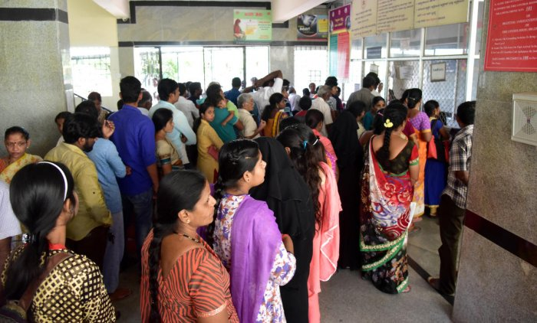
EXISTING SYSTEM
Wastage of precious time of people due to nonmanagement of time scheduling.
No proper mention the availability of doctors.
Not storing the previous data.
Security issues.
Wastage of time due to paper work

Slide 4
OBJECTIVES
Hospital information system is a project which aims in developing a computerized system to maintain all the daily work of hospital.
It has a facility of admin login through which the admin can monitor the whole system.

Slide 5
MODULES
ADMIN PANEL - Login , manage doctor, patient , appointment
DOCTOR PANEL – Login , view appointment, cancel appointment.

Slide 6

ADMIN
DASHBOARD: Admin can View Total Number Of Patient , Appointment And Doctor.
DOCTOR: Admin can manage doctors(edit , delete,view,add).
PATIENT: Admin can manage the patients(edit, delete,view,add).
APPOINTMENT: Admin can manage the appointments (edit ,create, view)

Slide 7

DOCTOR
DOCTOR: Doctor can view the total number of patients and appointments.
LOGIN: Doctor can login and monitor the whole activities.
APPOINTMENT: Doctor can view the appointments and also cancel the appointments.

Slide 8
ADVANTAGES
Reduce paper work.
It is window based hospital information software that has password facility to ensure high level of security.
It has centralized database system
It is a huge time saver and minimize yours repeated works.

Slide 9

TECHNOLOGIES USED
PYTHON:
Python Is a Computer Programming Language And It Is Case Sensitive ,Interpreted And Indentation Based Language.
TKINTER:
It is a Standard GUI Library For Python.It Is Used To Design Desktop Applications Fastly.

Slide 10

SQLite(database):
SQLite is a software library that implements a self contained ,serverless and database engine written in ‘C’ language.
Its developer name was D.Richard Hipp

Slide 11
REQUIREMENTS
HARDWARE:
i3 processor ,4GB RAM ,32-bit operating system.
SOFTWARE:
Python Interpreter, Visual Studio Code

Slide 12
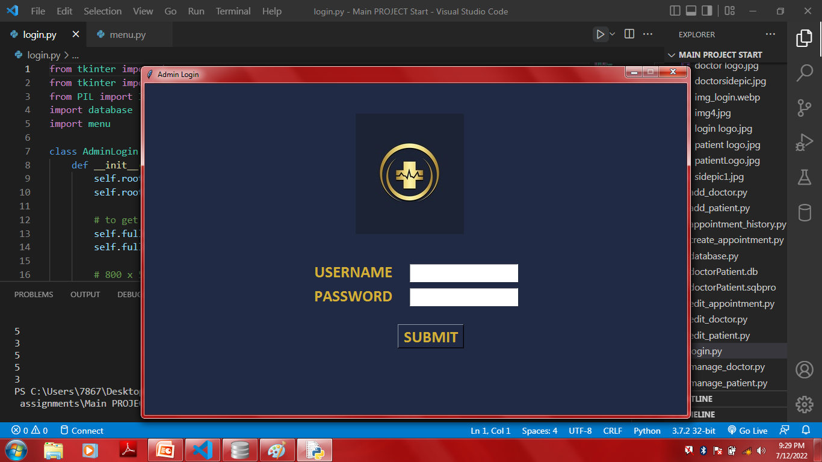
SCREENSHOTS

Slide 13
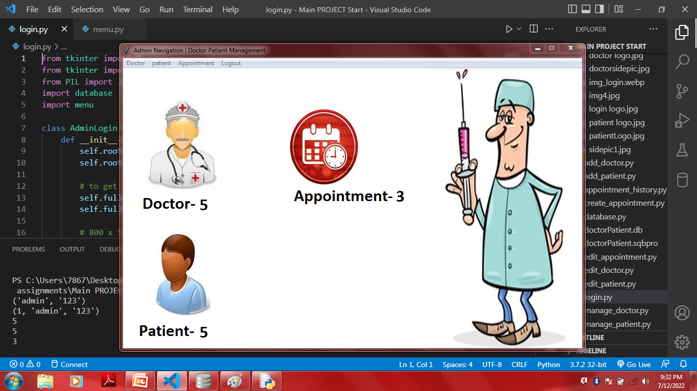

Slide 14
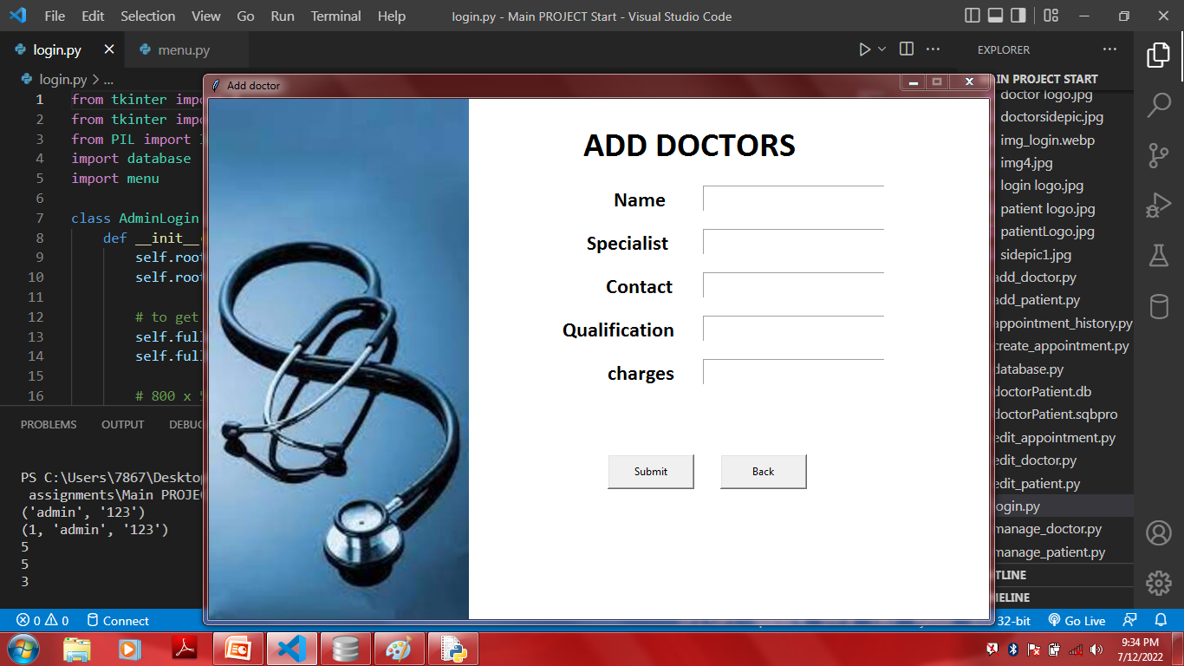

Slide 15
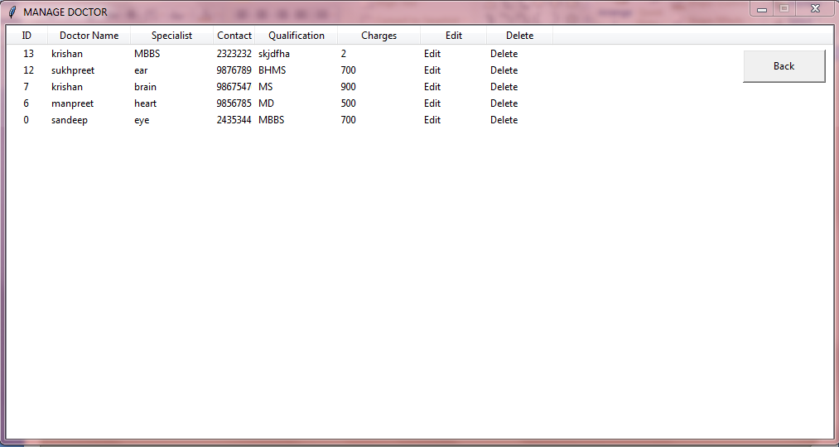

Slide 16
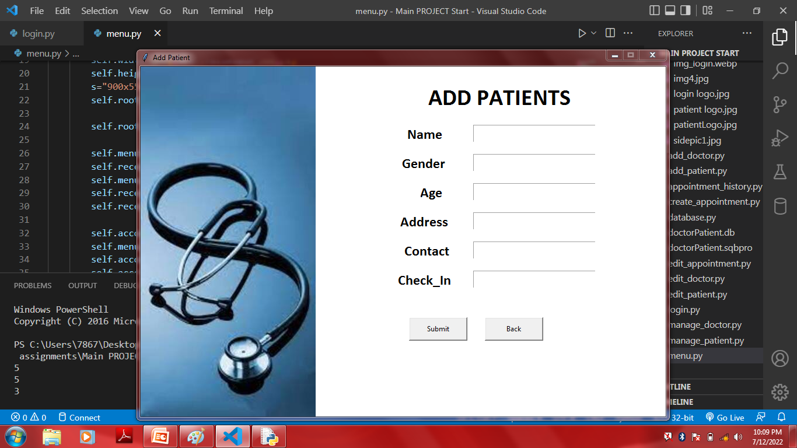

Slide 17
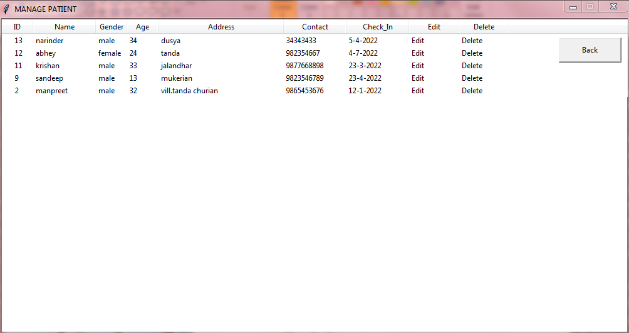

Slide 18
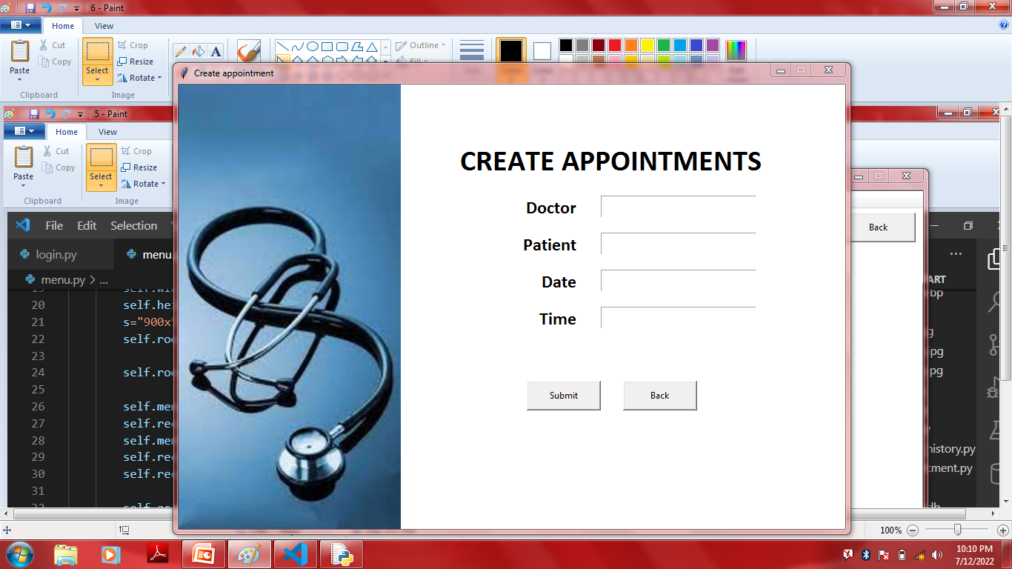

Slide 19
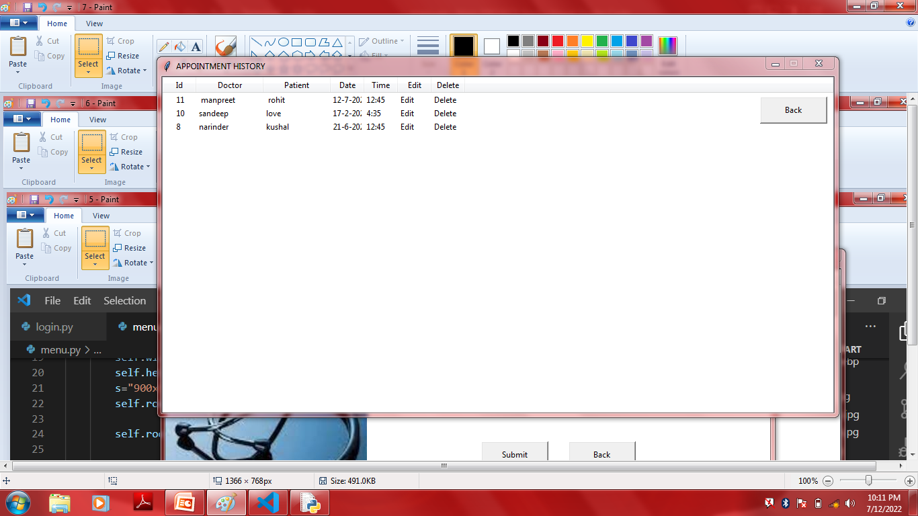

Slide 20
CONCLUSION
The project titled “Hospital Information System” is ,mainly reduce the paper work and human efforts and create hassle-free system for both hospital and patients.

Slide 21
FUTURE WORK
The future implementation will be online help for patients. and also book the appointment with doctor in online mode .

Slide 22
THANK YOU

